Slide 1
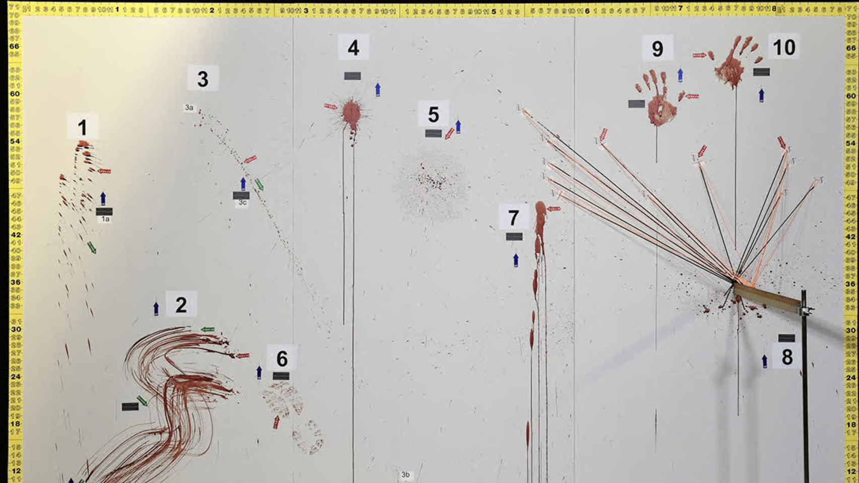
Intro to Blood Pattern Analysis
For SLCSE – Rose Park
Introduction to Medical Forensics
Developed by: Thomas A. Delgado, MA*
*Contributions from Marion Davidson MSc – Loyola University

Slide 2

Goals
Describe
the utility (and limitations) in the interpretations of blood patterns to crime scene investigation
Understand
the three main types of bloodstain patterns
Understand
forces that create different types of bloodstain patterns
Compare
how different physical effects alter the shape of blood droplets
Describe
how different blood patterns can be created

Slide 3

Intro Video

Slide 4
What is Blood Pattern Analysis (BPA)?
What is a Bloodstain?
Deposit of Blood on Some Surface
What is a Bloodstain Pattern?
An organized distribution or grouping of bloodstains that is potentially informative

Slide 5
What is Blood Pattern Analysis (BPA)?
What is Blood Pattern Analysis?
The examination of shape, size, location, distribution of bloodstains to provide an interpretation on their origin

Slide 6
What Does BPA Require?
Understanding Physical Properties of Blood
Scales
Understanding of Physics and Fluid Dynamics
Direction
Angles
Robust Documentation

Slide 7
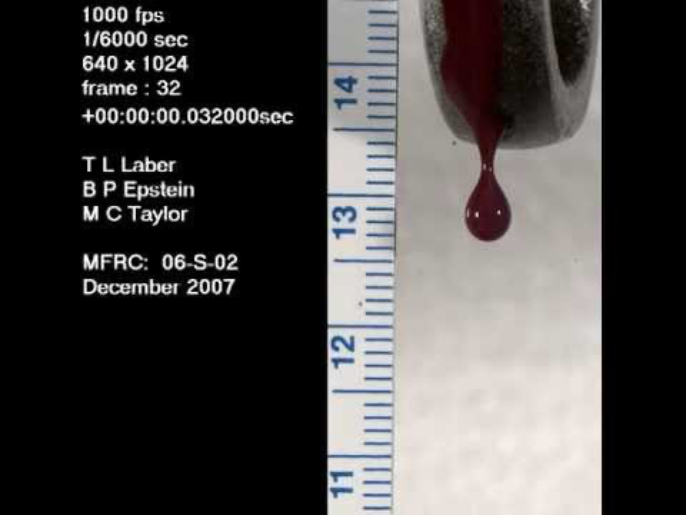
Physical Properties of Blood
What is Surface Tension?
Determined by fluid molecule bonds
Ability to resist external force
Pulls molecules to center
So Blood Droplets are Always Spherical
(in isolation)

Slide 8
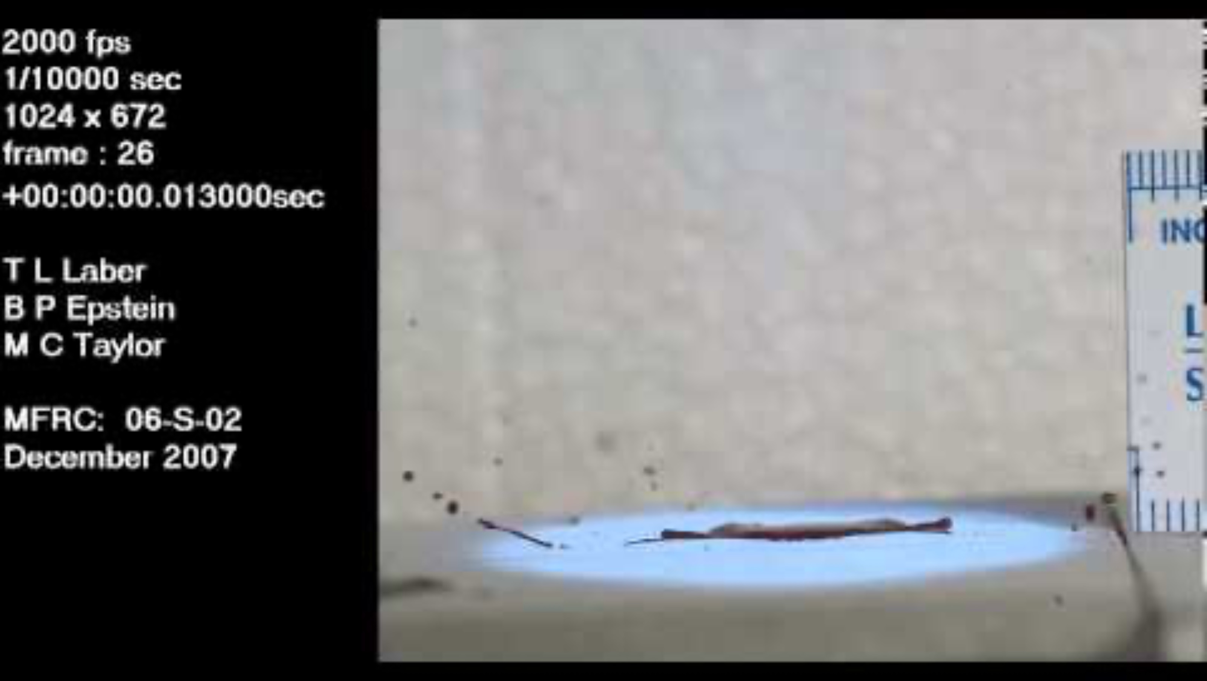
Physical Properties of Blood
Surface Tension >
Gravity/Air Resistance
So regardless of a droplet’s
Velocity
Speed in a direction
It remains a sphere until acted on
by an external force
Notes:
And you can even see there are little satellite spheres coming off of this drop on impact

Slide 9
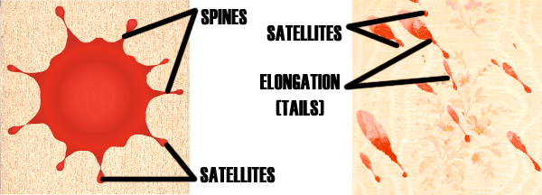
Anatomy of a Stain
Parent Stain
Spines
Main/First Drop on a Surface
Parent Stain
Satellites
Small Droplets Around Parent
Spines
Satellites
Thin Spokes – Connect Parent and Satellites
Notes:
And you can even see there are little satellite spheres coming off of this drop on impact

Slide 10
Anatomy of a Stain
Satellites
Tails
Elongation in a Single Direction
Tails
Come from Oval Parent Stain
Suggest Angle of Impact
Point to Direction of Travel
Notes:
And you can even see there are little satellite spheres coming off of this drop on impact

Slide 11
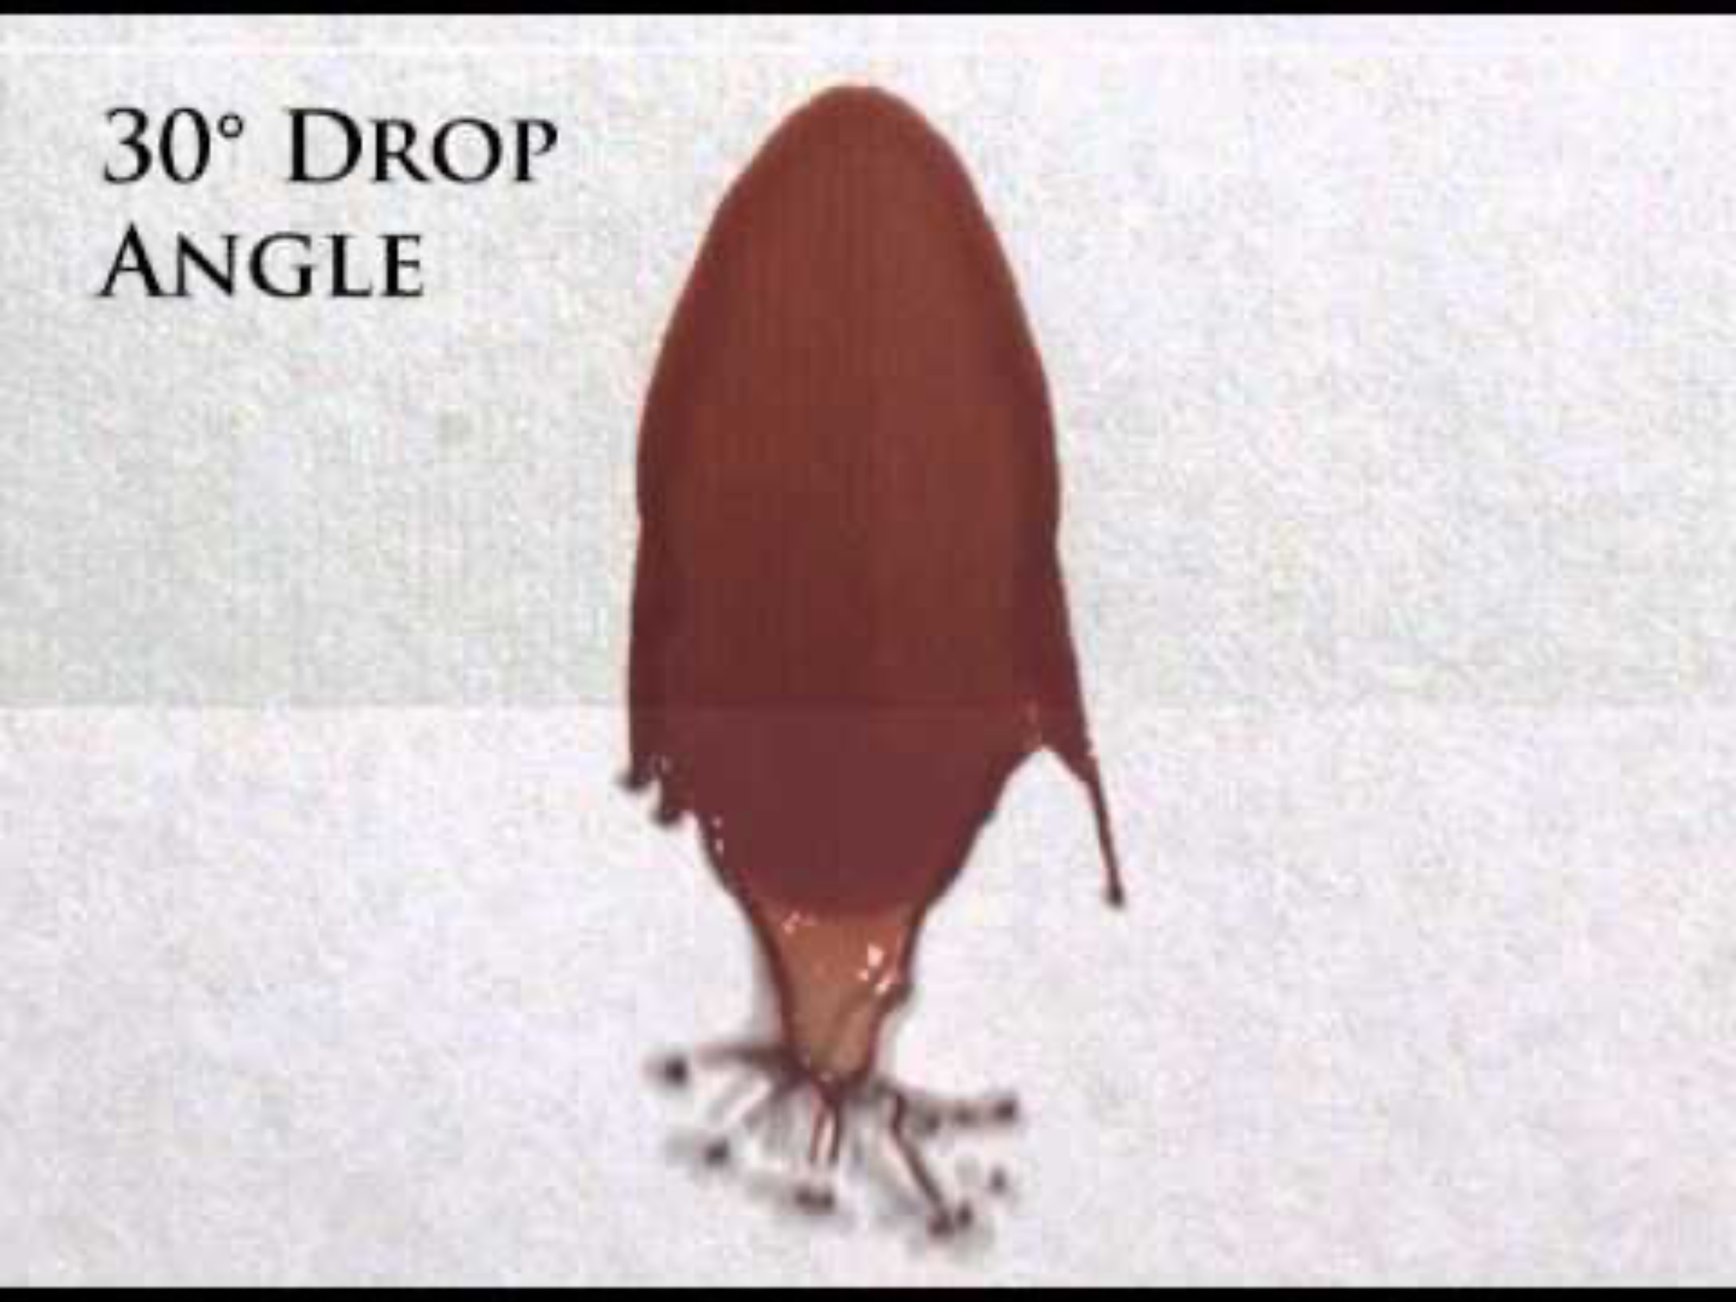
Anatomy of a Stain
Tails
Get Longer With Steeper Angles
Notes:
And you can even see there are little satellite spheres coming off of this drop on impact

Slide 12
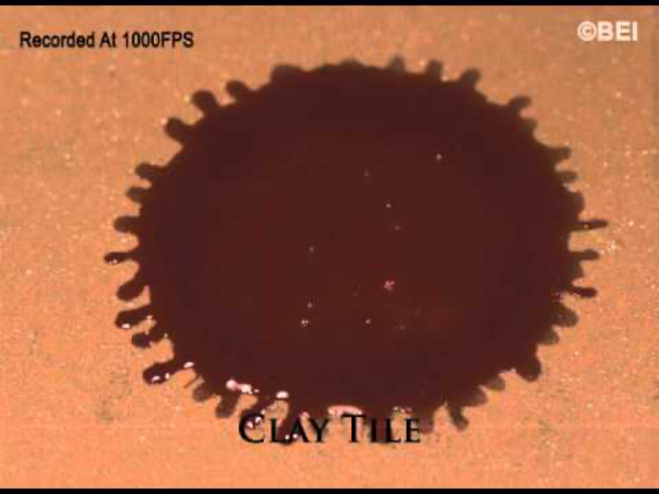
Surface Texture Effects
Porous v Non-Porous
Amount of Absorption
Rough v Smooth
Amount of Spatter
Smooth + Non-Porous = Smooth Edges/Little Spatter
Rough + Porous = Rough Edges/More Spatter
Notes:
And you can even see there are little satellite spheres coming off of this drop on impact

Slide 13
Categories of Blood Patterns
Passive
Transfer
Spatter
Drops
Impressions
Impact
Flows
Swipes
Cast-Off
Volumes
Wipes
Projected
Forward Spatter
Expirated
Back Spatter
Notes:
And you can even see there are little satellite spheres coming off of this drop on impact

Slide 14
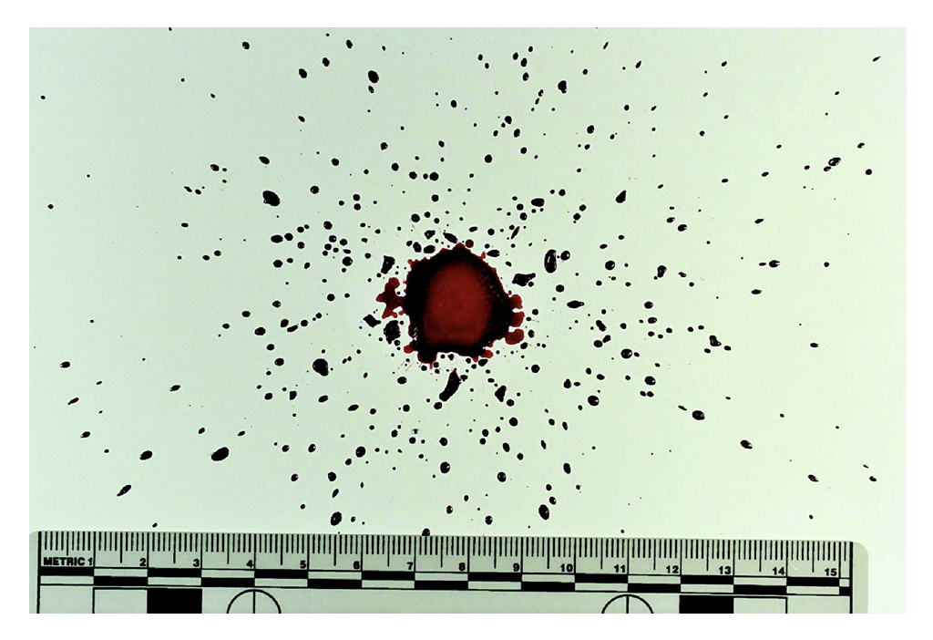
Passive Patterns
Created by no other force than gravity
Drip Stain = “Drop”
Drip Trail = “Blood Trail”
Notes:
And you can even see there are little satellite spheres coming off of this drop on impact

Slide 15


Passive Patterns
Created by no other force than gravity
Flow Pattern
Volume of Blood Moves with Gravity
Forms Rivers/Streams of Blood
Notes:
And you can even see there are little satellite spheres coming off of this drop on impact

Slide 16
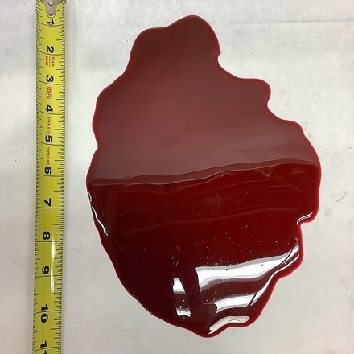
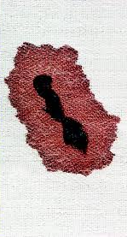
Passive Patterns
Created by no other force than gravity
Volumes
Accumulation on a Surface
Pool = on top of surface
Saturation = absorbed into surface
Notes:
And you can even see there are little satellite spheres coming off of this drop on impact

Slide 17
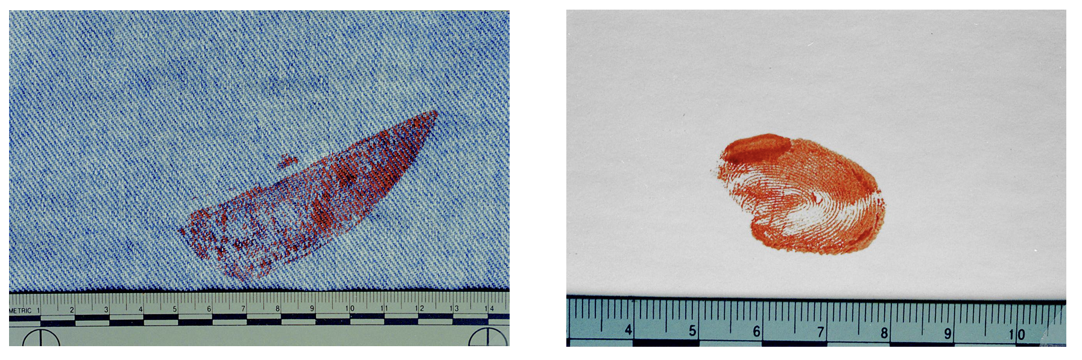
Transfer Patterns
Created by contact of a bloody surface with another
Impression
Bloodied object leaves a pattern of its characteristics on another surface
Notes:
And you can even see there are little satellite spheres coming off of this drop on impact

Slide 18
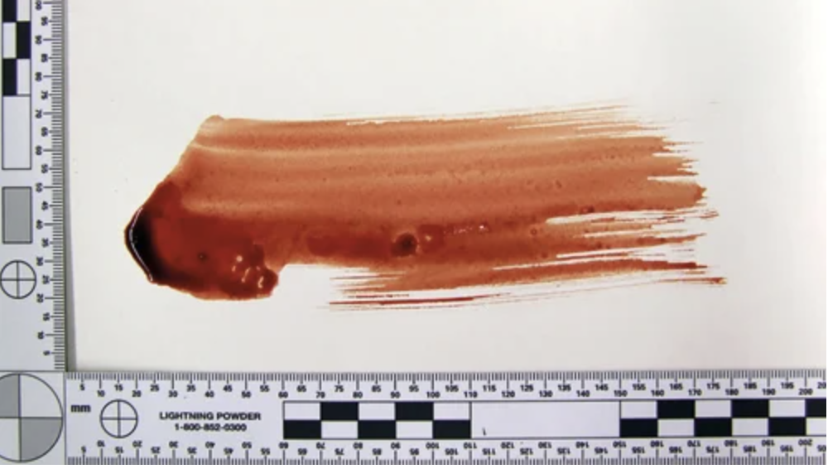
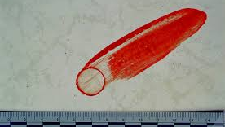
Transfer Patterns
Created by contact of a bloody surface with another
Swipe
Blood transfer from a bloody surface
Wipe
Object moves through pre-existing bloodstain
Notes:
And you can even see there are little satellite spheres coming off of this drop on impact

Slide 19
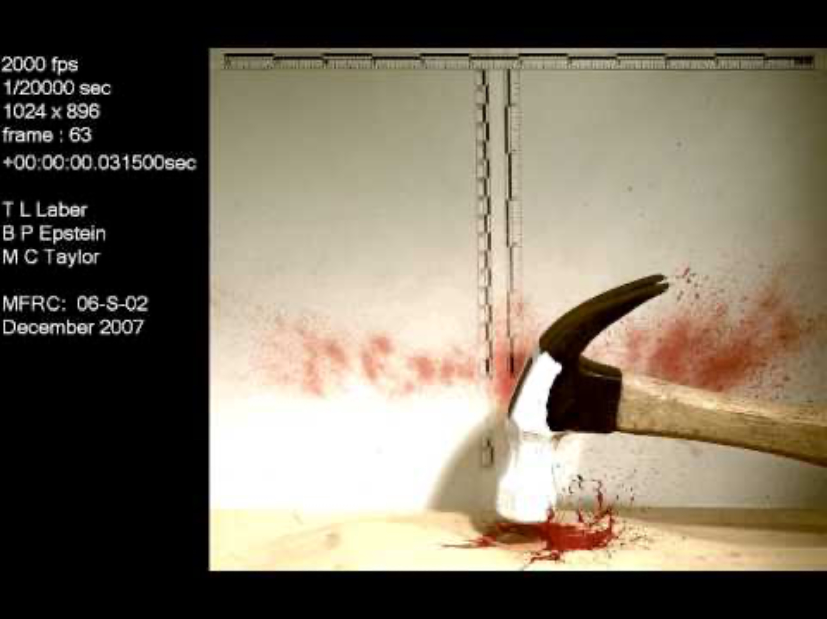
Spatter Patterns
Created by external force on an open source of blood or by making blood airborne
Impact
When an object strikes blood
Notes:
And you can even see there are little satellite spheres coming off of this drop on impact

Slide 20
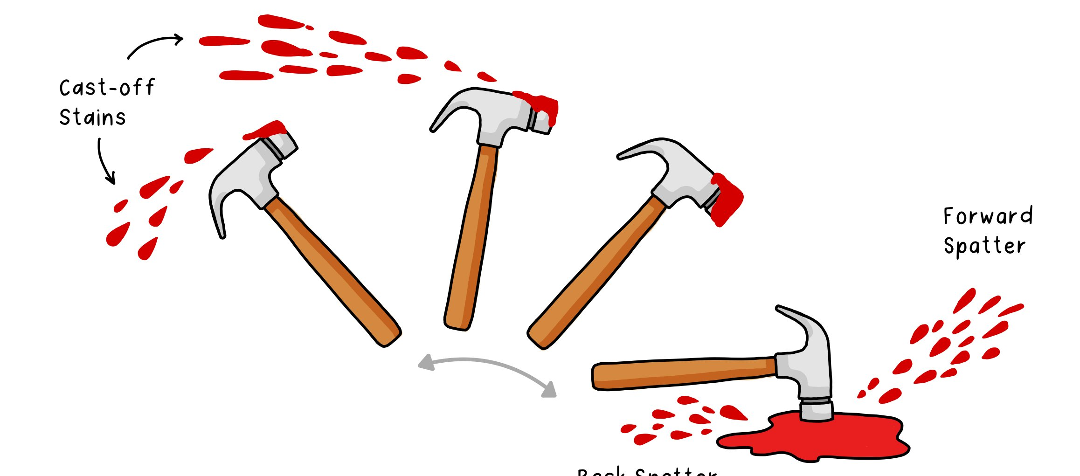
Spatter Patterns
Created by external force on an open source of blood or by making blood airborne
Cast-Off
Cast-Off
Blood flung by a bloodied object
Impact
Multiple elliptical stains with long tails
Notes:
And you can even see there are little satellite spheres coming off of this drop on impact

Slide 21
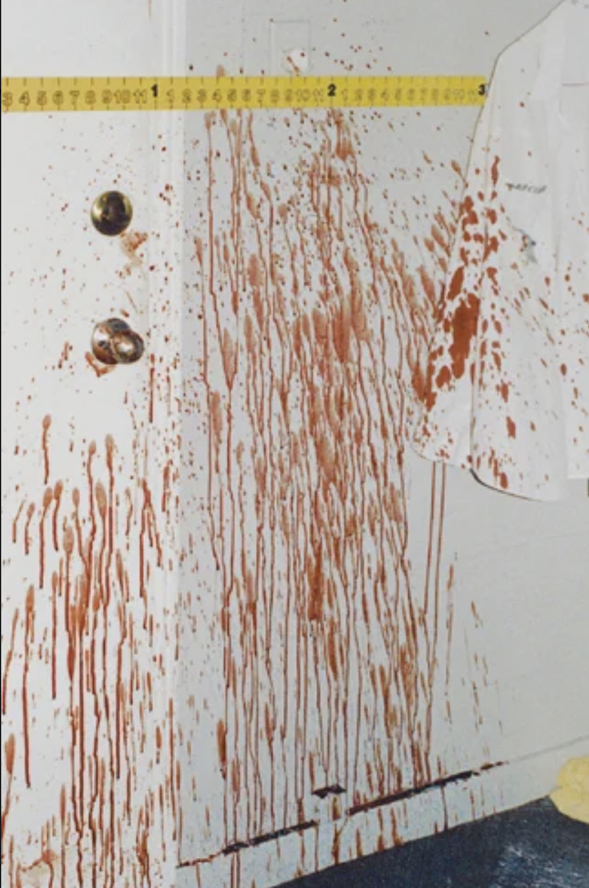
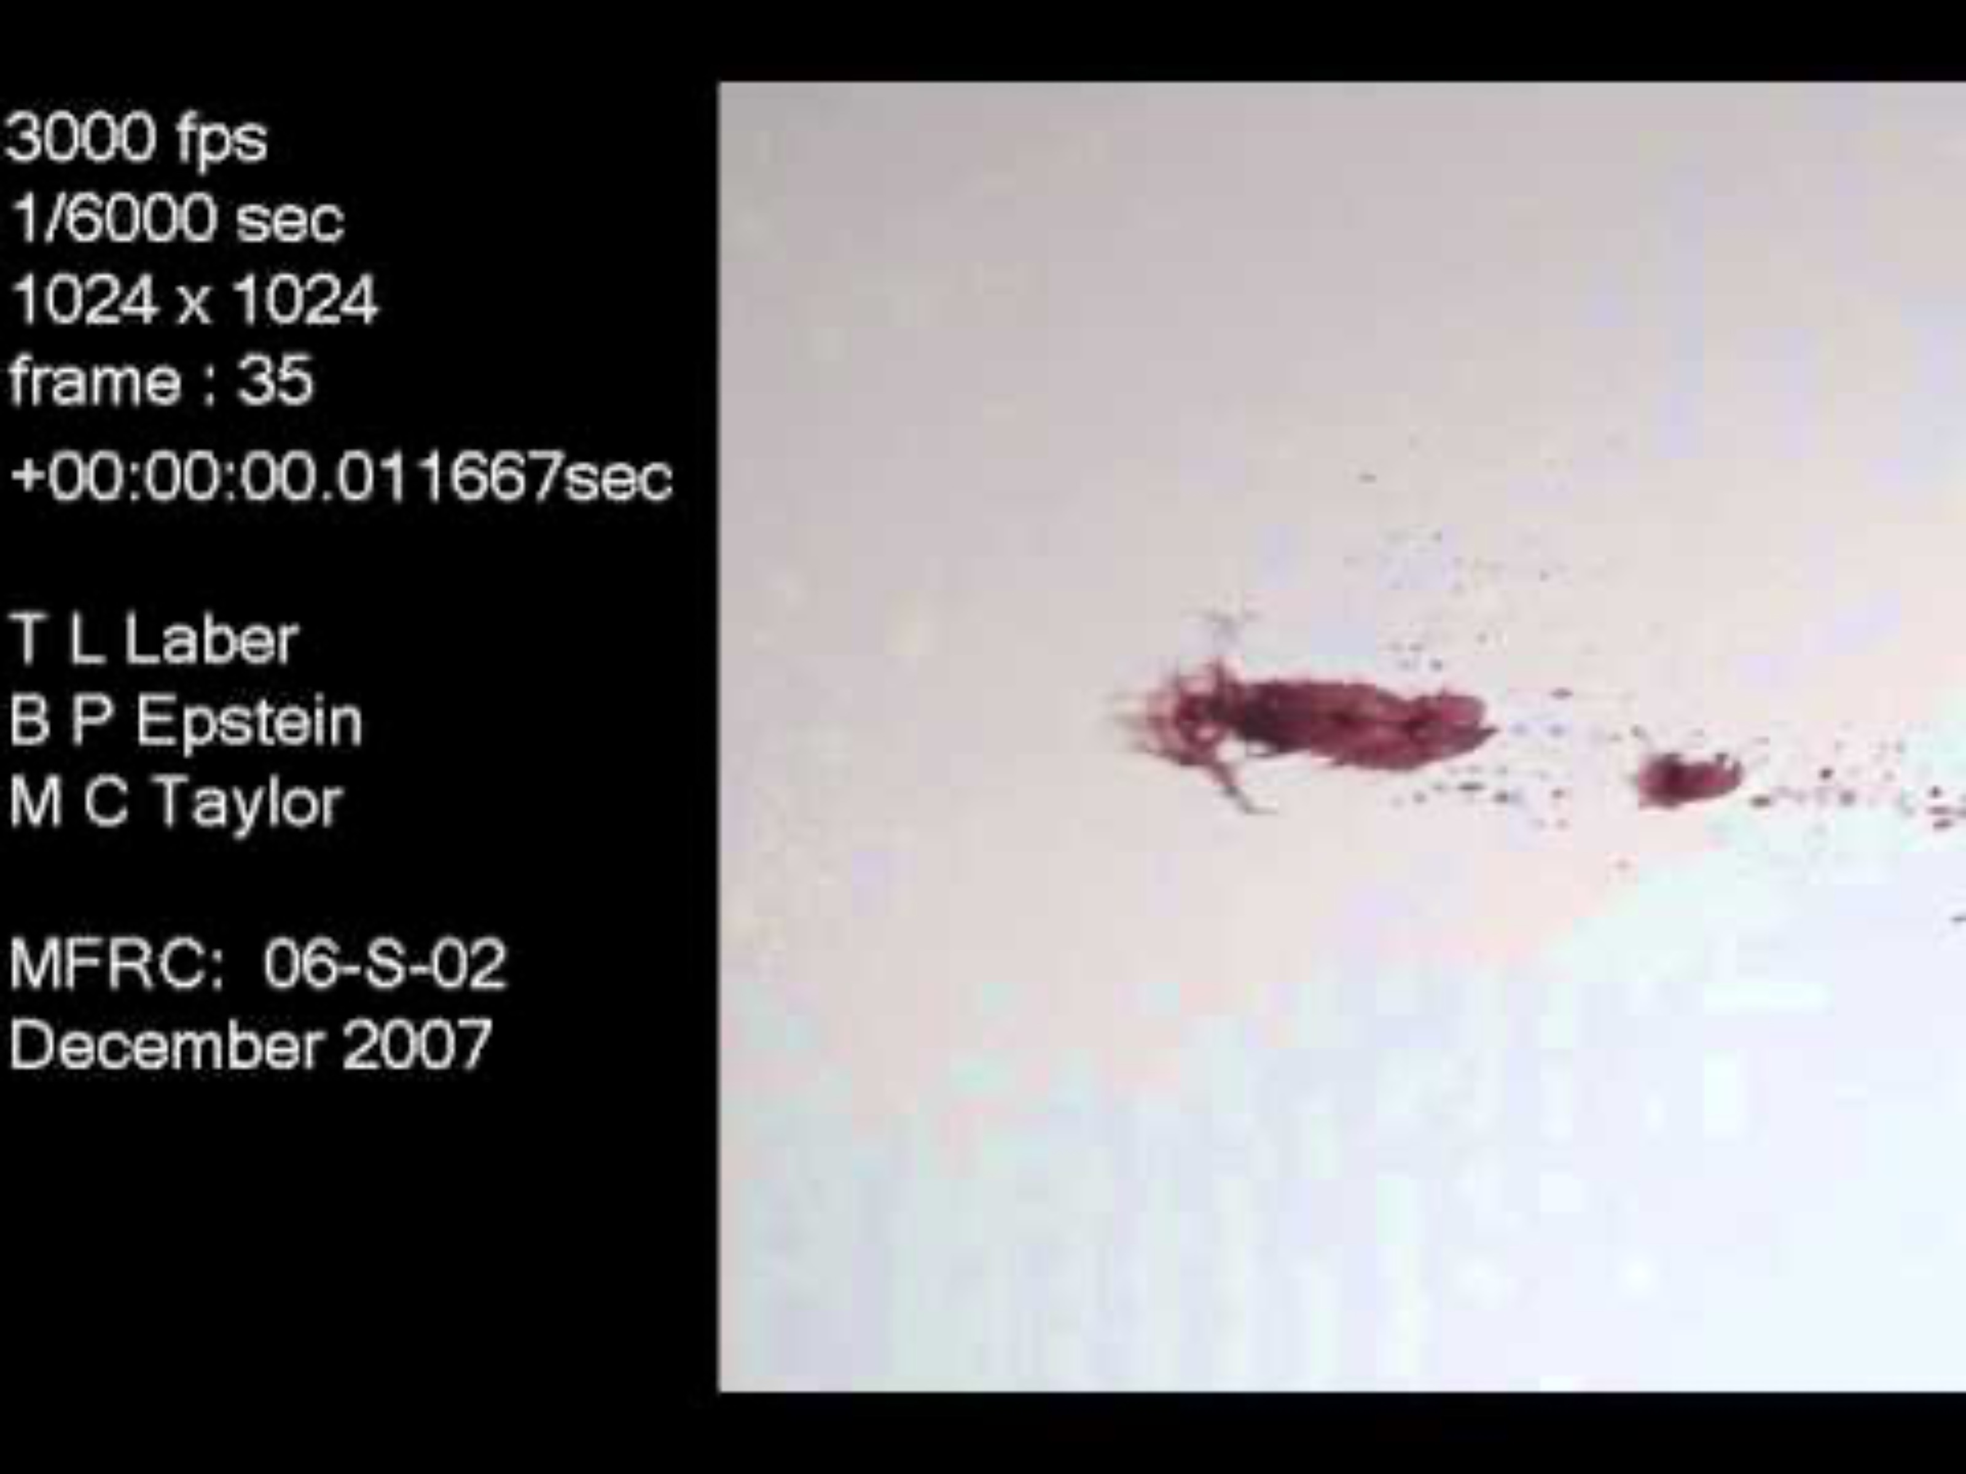
Spatter Patterns
Created by external force on an open source of blood or by making blood airborne
Projected
Blood distributed from pressure (artery)
Higher velocity than gravity
Notes:
And you can even see there are little satellite spheres coming off of this drop on impact

Slide 22
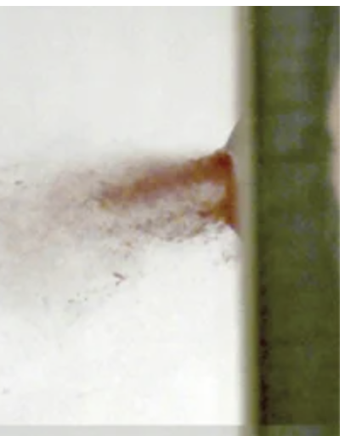
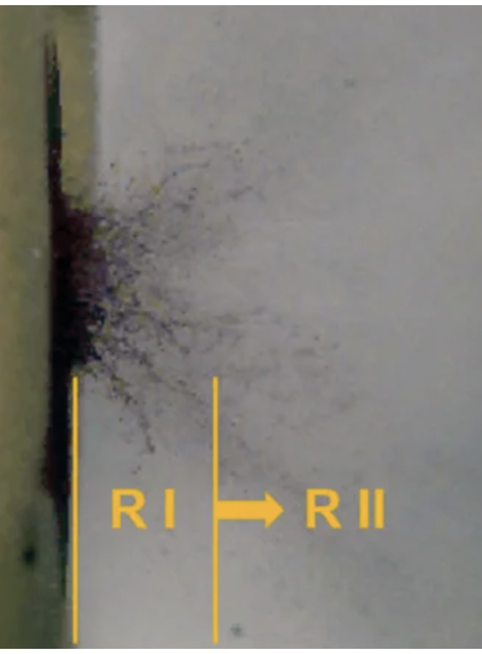
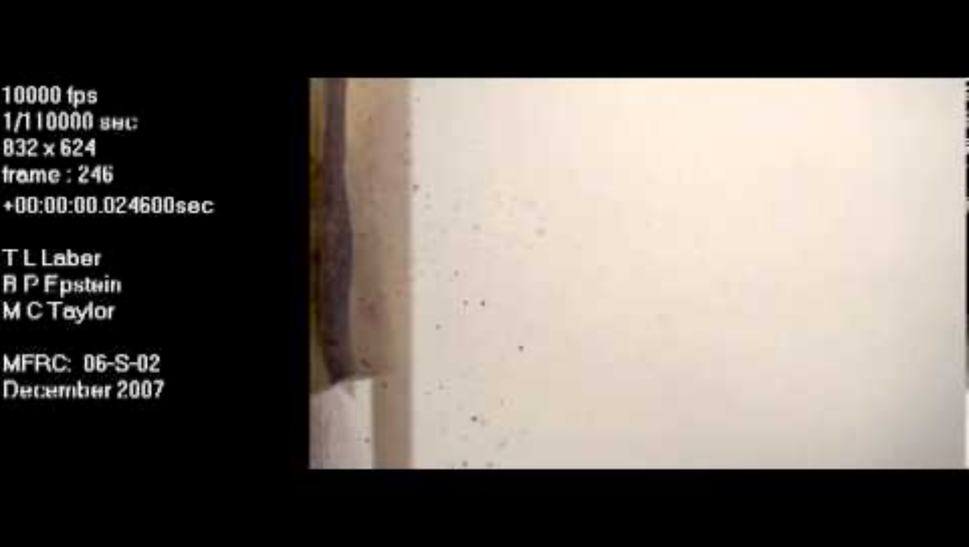
Spatter Patterns
Created by external force on an open source of blood or by making blood airborne
Firearm Spatter
Mist like distribution (fine particles)
Forward Spatter – on entrance
Back Spatter – on exit
Notes:
And you can even see there are little satellite spheres coming off of this drop on impact

Slide 23
Note Taking Activity 1 - Fill in the Blank:
The primary bloodstain patterns are: ________________ patterns, _______________ patterns, and ________________ patterns.
______________ patterns are created when a(n) _______________ _____________ interacts with an open source of blood.
A(n) ______________ occurs when a bloodstain has characteristics of an object in its pattern and is a type of _______________ pattern.
______________ patterns are created when a(n) ______________ surface interacts with another surface.
______________ patterns include _________ (e.g., drip stain or trail), __________, and ___________ (e.g., pools).
A bloodstain consists of the parent stain and possible _______________ that are connected to the parent stain by _______________.
______________ patterns are created with only the force of _________________.
Flinging blood from a blood-covered object is known as ________________ and is a type of _____________ pattern.

Slide 24
Note Taking Activity 1 - Fill in the Blank (KEY):
The primary bloodstain patterns are: passive patterns, transfer patterns, and spatter patterns.
Spatter patterns are created when a(n) external force interacts with an open source of blood.
A(n) impression occurs when a bloodstain has characteristics of an object in its pattern and is a type of transfer pattern.
Passive patterns include drops (e.g., drip stain or trail), flows and volumes (e.g., pools).
A bloodstain consists of the parent stain and possible satellites that are connected to the parent stain by spines.
Transfer patterns are created when a(n) bloody surface interacts with another surface.
Passive patterns are created with only the force of gravity
Flinging blood from a blood-covered object is known as cast-off and is a type of spatter pattern.

Slide 25

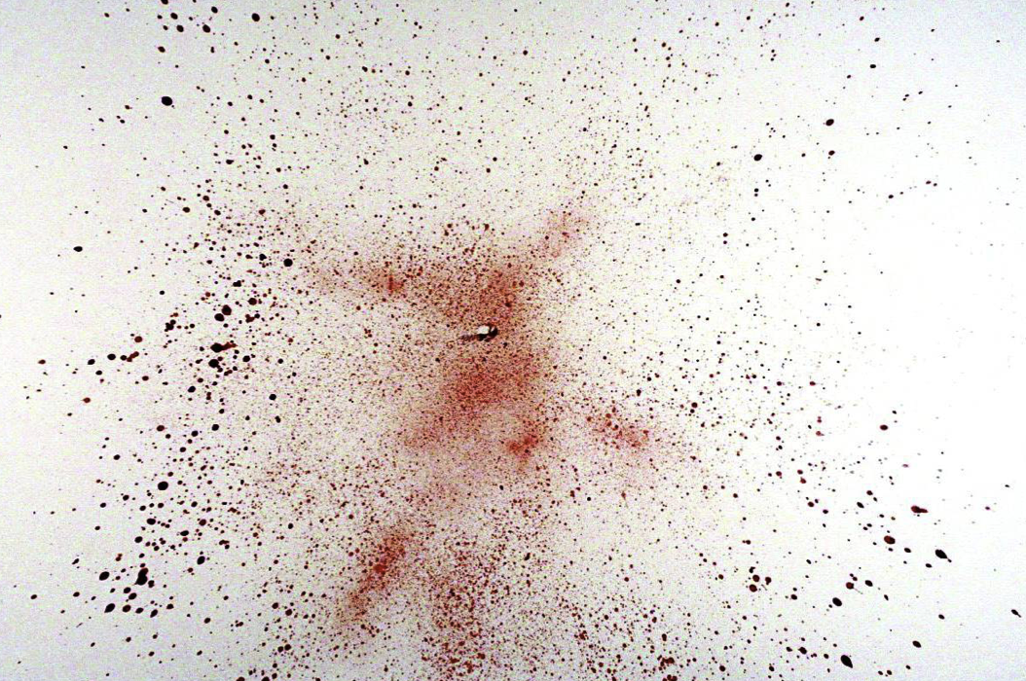
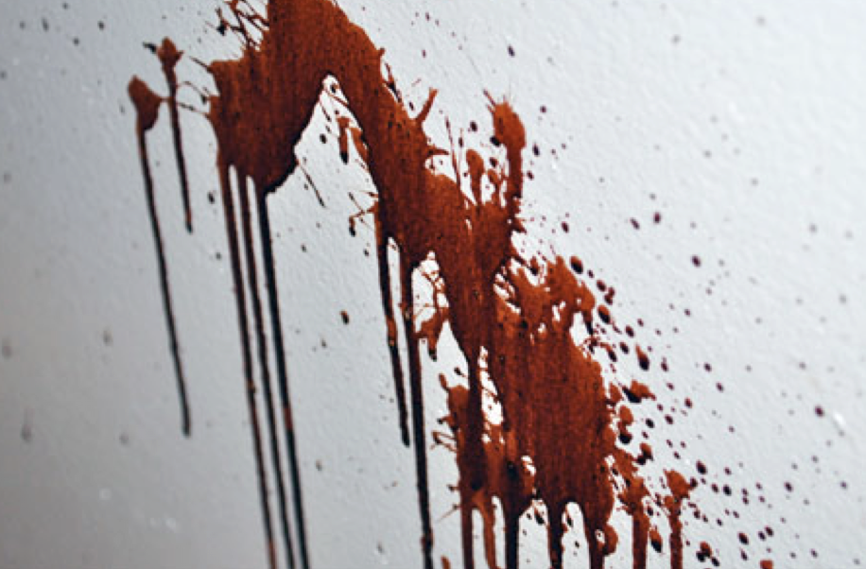
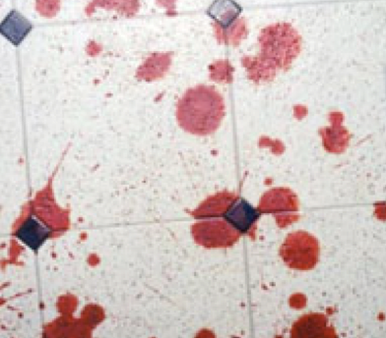
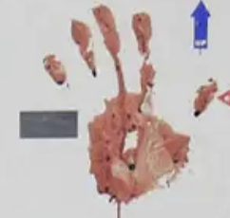
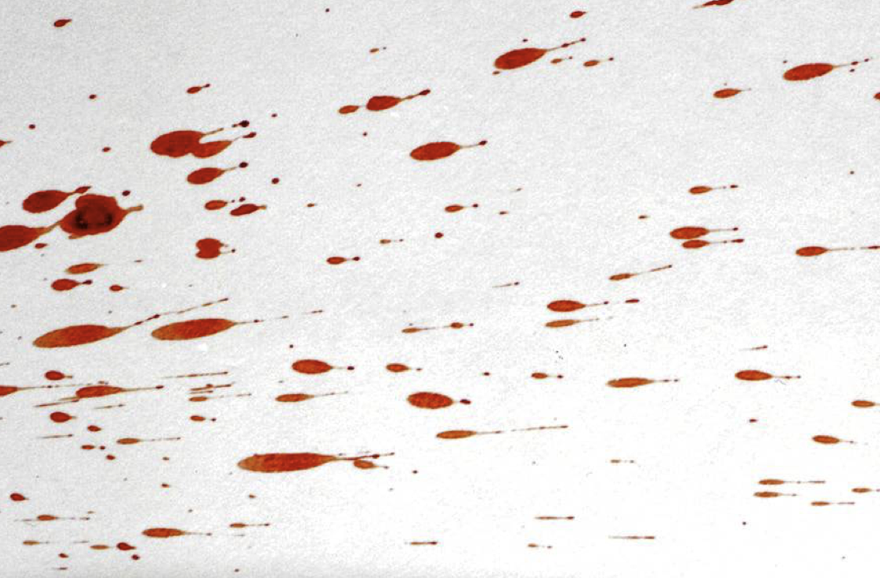
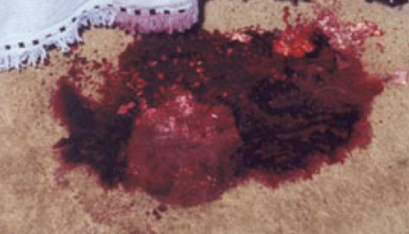
Note Taking Activity 3 - Matching:
Match the bloodstain with its correct pattern:
Passive
Transfer
Spatter

Slide 26
Note Taking Activity 3 – Matching (KEY):
Match the bloodstain with its correct pattern:
Passive
Transfer
Spatter
Flow
Forward Spatter
Swipe
Pool
Cast-off
Impression
Drops

Slide 27
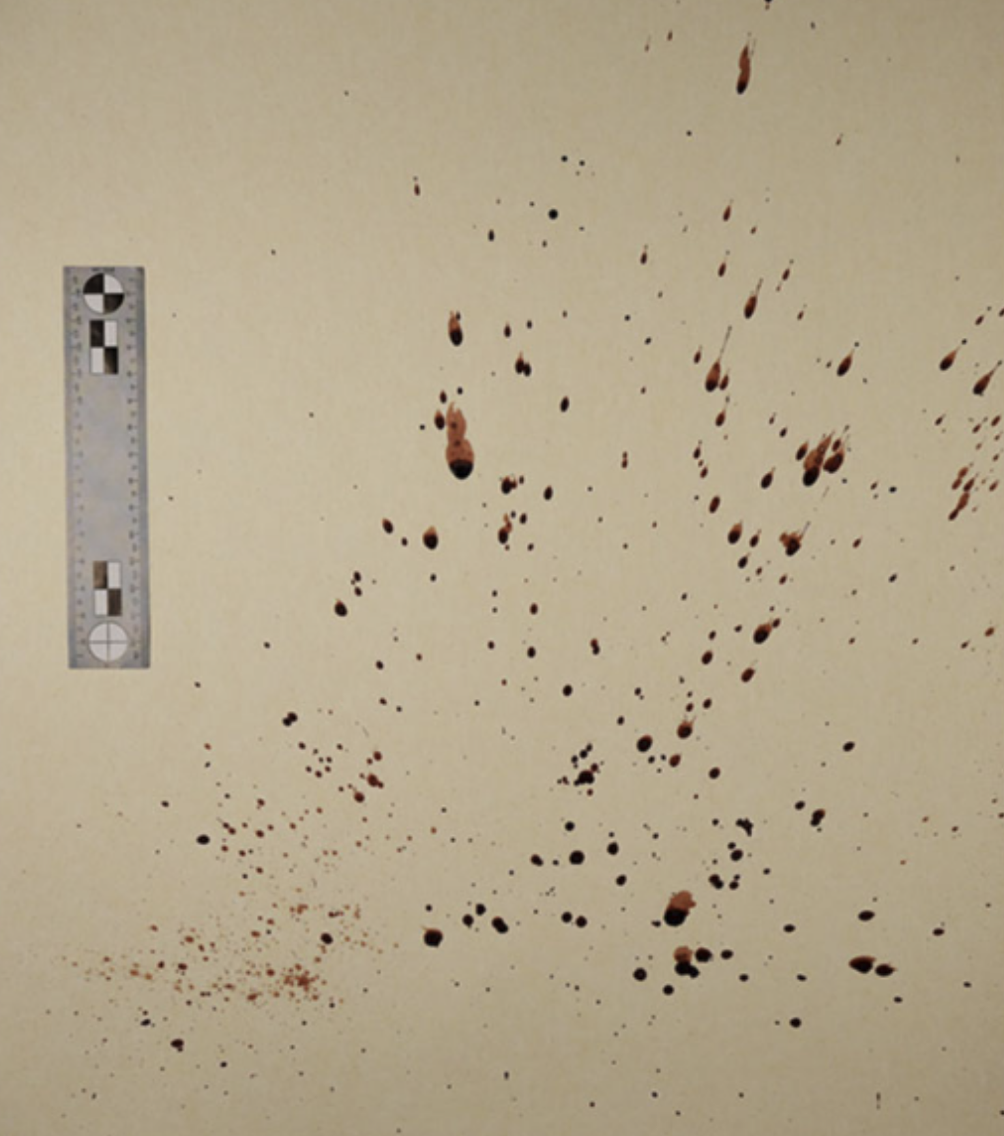
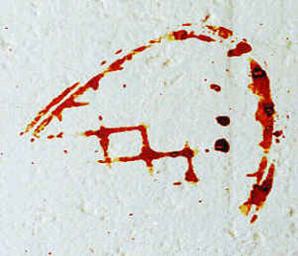
Name That Blood Pattern
Passive/Transfer/Spatter
Notes:
I did this as a rapid-fire “yell out the name” introduction before the discussion/lab (a different day than the note taking activities/lecture) and also tried to have a short breakdown of each one (have them try to remember the specific type/wonder what the impressions are/what could a source be)

Slide 28
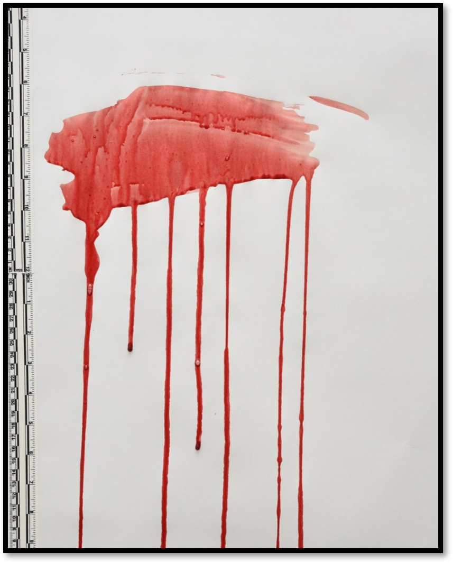
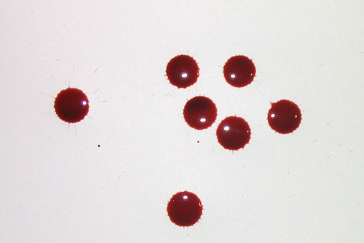
Name That Blood Pattern
Passive/Transfer/Spatter

Slide 29
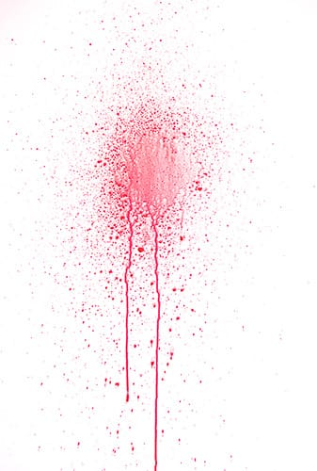
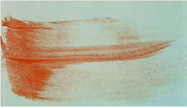
Name That Blood Pattern
Passive/Transfer/Spatter

Slide 30
Discussion: How Reliable do You Think BPA is? What are its Strengths? Limitations?
Write Your Thoughts – 1 Minute
Turn to Neighbor and Share – 2 Minutes
Class Discussion
Notes:
Main topics include subjectivity v objectivity, limitations of the science, some discussion of 2009 NAS Report on Forensic Science that wasn’t covered in the lecture (I called this a “moment of honesty”)

Slide 31
Lab Activity 1 – The Effect of Height
Materials:
Easel Paper (or similar large format paper)
Markers
Rulers/calipers
Meter Sticks/Measuring tape
Pipettes
Simulated Blood
Graph Paper
Premise:
Height effects the size of blood droplets and which can provide insights in a crime scene investigation
As height increases, the velocity of the droplet will increase and alter its impact characteristics
This lab will explore those alterations and how pervasive/dramatic those are at different heights
* Students should alternate roles
This activity can be done in student groups of 2-4* – they will need to acquire the needed materials
Create a table like the one provided
Use a meter stick/measuring tape and determine each origin
height
Using a pipette filled with simulated blood, drop 6-9 droplets of
blood onto the paper and draw a box around them with the height
Try to avoid dropping onto other drops!
(ensure pipette tip is at origin height)
Once dry, measure (in mm) the diameter of each blood drop and
then calculate the average size.
Do all measurements at the end of experiment
On a graph paper, make a scatterplot of origin height (x) versus
droplet size (y)

Slide 32
Lab Activity 2 – The Effect of Angle of Impact
Materials:
Clipboard with Printer Paper
Protractor
Rulers/calipers
Pipettes
Simulated Blood
Graph Paper
Premise:
Estimating the the angle at which blood impacts a surface can inform origin and directionality of the blood source.
The severity of the angle at which a droplet impacts a surface will affect its size and shape.
This lab will explore those alterations and show how changes are related
* Students should alternate roles
This activity can be done in student groups of 2-4* – they will need to acquire the needed materials
Either provide or have students create the table displayed
Blood will be dropped onto the clipboard with angles determined with
the protractor.
One edge of clipboard should always be on table
One student should hold protractor, another angling clipboard,
one holding ruler for consistent height, and one dropping blood
Use a consistent height between 30-50cm from where you aim to drop
the blood and drop 3-5 drops for each angle – be sure to label drops
between the trials (use multiple sheets if needed)
Once dry, measure the length and width of each drop (mm) and record
the average
On a graph paper, make two scatterplots: 1) angle (x) versus
droplet width (y) and 2) angle (x) versus droplet length (y)
Notes:
Make sure the students are taking the angle with the protractor center at the stable edge (“hinge”) of the clipboard so angles are correct

Slide 33
Lab Write Ups
How did blood droplet size change as height increased? Was this change consistent at every height?
How did blood droplet shape and features change as height increased (e.g., presence/absence of satellite drops)
How did blood droplet length and width change as angle increased?
How distinctive do you feel the difference in bloodstain patterns are? What are some limitations to this type of analysis?

